Slide 1

PROVIDE LAST ACTIVITY

Slide 2
PROVIDE LAST ACTIVITY
OVERVIEW
Scope of the microservice :
Provide Last Activity of an individual
Possible requests :
GET {url}/{gin} : Provide the last activity of the individual with the given GIN
Documentation :
Triggers and procedure: https://confluence.devnet.klm.com/display/repind/LAST_ACTIVITY
Micro service: https://confluence.devnet.klm.com/display/repind/Provide+last+activity
Database table used:
Table
INDIVIDUS_ALL
ADR_POST
EMAILS
TELECOMS
EXTERNAL_IDENTIFIER
ROLE_CONTRATS
ROLE_UCCR
COMMUNICATION_PREFERENCES
PREFERENCE
DELEGATION_DATA
HANDICAP

Slide 3


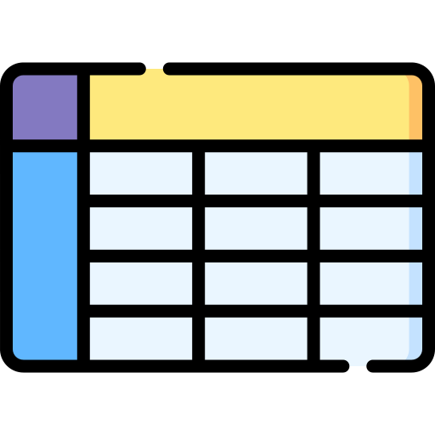


PROVIDE LAST ACTIVITY
INITIALISATION BATCH AND TRIGGERS
Phase 1:
Last activity table population
by one-shot batch
Phase 2:
Last activity table update
by triggers
Batch
Last activity table
Trigger
Trigger

Slide 4
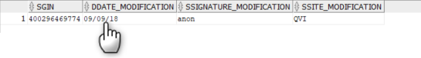
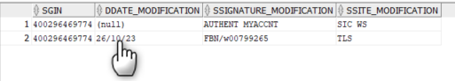
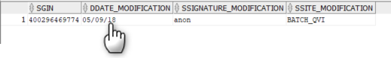
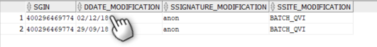
PROVIDE LAST ACTIVITY
INITIALISATION BATCH EXAMPLE
INDIVIDUS_ALL
ROLE_CONTRATS
Batch
TELECOMS
EMAILS
LAST_ACTIVITY

Slide 5
PROVIDE LAST ACTIVITY
TRIGGERS EXAMPLE
Last activity (Before)
Last activity (After)
Trigger individual
Last activity (Before)
Last activity (After)
Trigger Telecoms
Last activity (Before)
Trigger Adr_post
Last activity (After)

Slide 6
PROVIDE LAST ACTIVITY
EXAMPLE
Example database :
ID | GIN | dateModification | siteModification | signatureModification | SourceModification
24 | 900055558366 | 17/11/23 | AMS | BW_SUBS_AF-CAPI | INDIVIDUS
25 | 400754387676 | 26/10/23 | TLS | FBN/w00799265 | ROLE_CONTRATS
26 | 400622444643 | 17/11/23 | TLS | HACHIKO | ADR_POST
Get last activity by gin : 400622444643
{
"gin": "400622444643",
"dateModification": "2023-11-17T10:47:30.000+00:00",
"sourceModification": "ADR_POST",
"signatureModification": "HACHIKO",
"siteModification": "TLS"
}

Slide 7
PROVIDE LAST ACTIVITY
Demonstration

Slide 8
PROVIDE LAST ACTIVITY
PROCEDURE AND TRIGGERS
Triggers
After
Update or Insert
TRIGGER
INDIVIDUAL
TRIGGER
EMAILS
TRIGGER
TELECOM
TRIGGER
…
2
LAST ACTIVITY PROCEDURE
INITIALISATION BATCH
1
Last activity table
GIN | dateModification | siteModification | signatureModiication | SourceModification
… | … | … | … | …

